Slide 1
Intelligent Agents
In His Name
Chapter 2

Slide 2
Outline
Agents and environments
Rationality
PEAS (Performance measure, Environment, Actuators, Sensors)
Environment types
Agent types

Slide 3
Agents
An agent is anything that can be viewed as perceiving its environment through sensors and acting upon that environment through actuators
Human agent: eyes, ears, and other organs for sensors; hands, legs, mouth, and other body parts for actuators
Robotic agent: cameras and infrared range finders for sensors; various motors for actuators

Slide 4

Agents and environments
The agent function maps from percept histories to actions:
[f: P* → A]
The agent program runs on the physical architecture to produce f
agent = architecture + program

Slide 5

Vacuum-cleaner world
Percepts: location and contents, e.g., [A,Dirty]
Actions: Left, Right, Suck, NoOp

Slide 6
Rational agents
An agent should strive to "do the right thing", based on what it can perceive and the actions it can perform. The right action is the one that will cause the agent to be most successful
Performance measure: An objective criterion for success of an agent's behavior
E.g., performance measure of a vacuum-cleaner agent could be amount of dirt cleaned up, amount of time taken, amount of electricity consumed, amount of noise generated, etc.

Slide 7
Rational agents
Rational Agent: For each possible percept sequence, a rational agent should select an action that is expected to maximize its performance measure, given the evidence provided by the percept sequence and whatever built-in knowledge the agent has.

Slide 8
Rational agents
Rationality is distinct from omniscience (all-knowing with infinite knowledge)
Agents can perform actions in order to modify future percepts so as to obtain useful information (information gathering, exploration)
An agent is autonomous if its behavior is determined by its own experience (with ability to learn and adapt)

Slide 9
PEAS
PEAS: Performance measure, Environment, Actuators, Sensors
Must first specify the setting for intelligent agent design
Consider, e.g., the task of designing an automated taxi driver:
  Performance measure
  Environment
  Actuators
  Sensors

Slide 10
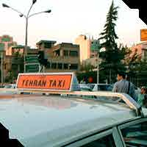
PEAS
Must first specify the setting for intelligent agent design
Consider, e.g., the task of designing an automated taxi driver:
  Performance measure: Safe, fast, legal, comfortable trip, maximize profits
  Environment: Roads, other traffic, pedestrians, customers
  Actuators: Steering wheel, accelerator, brake, signal, horn
  Sensors: Cameras, sonar, speedometer, GPS, odometer, engine sensors, keyboard

Slide 11
PEAS
Agent: Medical diagnosis system
Performance measure: Healthy patient, minimize costs and lawsuits
Environment: Patient, hospital, staff
Actuators: Screen display (questions, tests, diagnoses, treatments, referrals)
Sensors: Keyboard (entry of symptoms, findings, patient's answers)

Slide 12
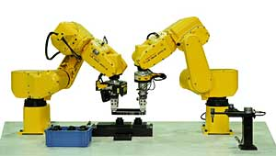
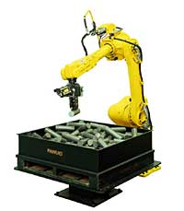
PEAS
Agent: Part-picking robot
Performance measure: Percentage of parts in correct bins
Environment: Conveyor belt with parts, bins
Actuators: Jointed arm and hand
Sensors: Camera, joint angle sensors

Slide 13
PEAS
Agent: Interactive English tutor
Performance measure: Maximize student's score on test
Environment: Set of students
Actuators: Screen display (exercises, suggestions, corrections)
Sensors: Keyboard

Slide 14
Environment types
Fully observable (vs. partially observable): An agent's sensors give it access to the complete state of the environment at each point in time.
Deterministic (vs. stochastic): The next state of the environment is completely determined by the current state and the action executed by the agent. (If the environment is deterministic except for the actions of other agents, then the environment is strategic)
Episodic (vs. sequential): The agent's experience is divided into atomic "episodes" (each episode consists of the agent perceiving and then performing a single action), and the choice of action in each episode depends only on the episode itself.

Slide 15
Environment types
Static (vs. dynamic): The environment is unchanged while an agent is deliberating. (The environment is semidynamic if the environment itself does not change with the passage of time but the agent's performance score does)
Discrete (vs. continuous): A limited number of distinct, clearly defined percepts and actions.
Single agent (vs. multiagent): An agent operating by itself in an environment.

Slide 16
Environment types
Chess with Chess without Taxi driving
a clock a clock
Fully observable Yes Yes No
Deterministic Strategic Strategic No
Episodic No No No
Static Semi Yes No
Discrete Yes Yes No
Single agent No No No
The environment type largely determines the agent design
The real world is (of course) partially observable, stochastic, sequential, dynamic, continuous, multi-agent

Slide 17
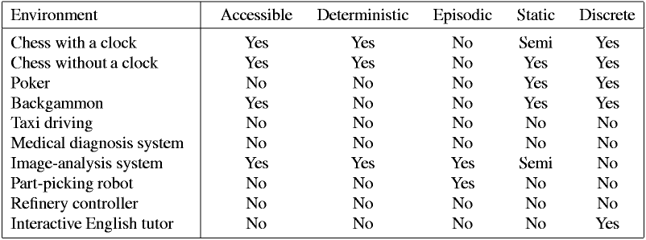
Environment types

Slide 18
Agent functions and programs
An agent is completely specified by the agent function mapping percept sequences to actions
One agent function (or a small equivalence class) is rational
Aim: find a way to implement the rational agent function concisely

Slide 19
Agent Program Types:
Look Up Table
Simple Reflexive
Model-based reflex agents
Goal-based agents
Utility-based agents

Slide 20
Look Up Table Agents
  Benefits:
    Easy to implement
  Drawbacks:
    Huge table
    Take a long time to build the table
    No autonomy
    Even with learning, need a long time to learn the table entries

Slide 21
Agent types
Five basic types in order of increasing generality:
Simple reflex agents
Model-based reflex agents
Goal-based agents
Utility-based agents
Learning Agents

Slide 22

Simple reflex agents

Slide 23

Model-based reflex agents

Slide 24

Goal-based agents

Slide 25

Utility-based agents

Slide 26

Learning agents

